Slide 1
Effective and Efficient API Misuse Detection via Exception Propagation and Search-Based Testing
2019 ISSTA （A）
University College London，Maria Kechagia

Slide 2
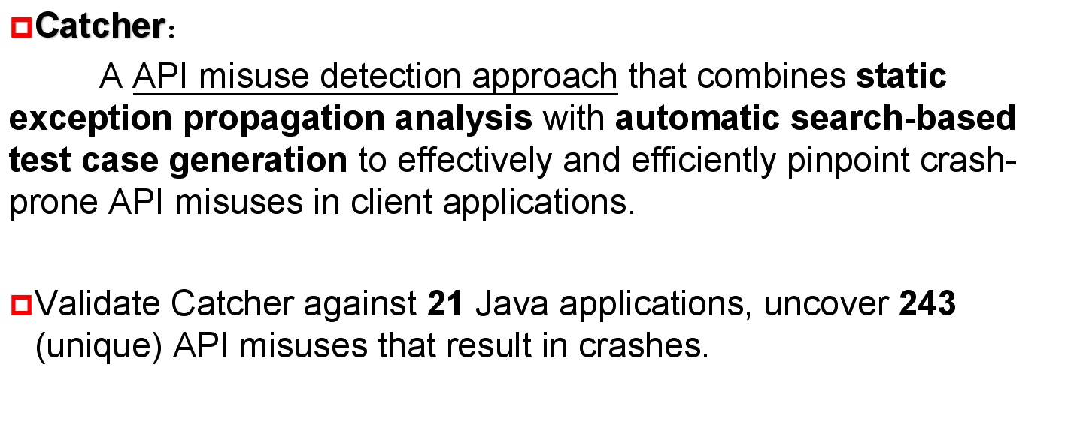
ABSTRACT

Slide 3
INTRODUCTION
Correctly using third-party APIs is not an easy task;
API misuses can cause software reliability problems, or even increasing the attack surface of client applications.
Static API misuse detectors：a high rate of false positives, requiring developers to manually inspect.
Dynamic analysis tools： without any false positives，balance vast search space and time budget

Slide 4
MAIN IDEA
Restrict the search space of automatic test case generators to crash-prone api-call locations (candidate misuses), i.e., method calls that might throw exceptions at runtime.
Combines static exception propagation analysis(SOOT) and test case generation(EvoSuite) to effectively and efficiently discover candidate misuses.
  (i) the detection of misuses of the Java platform’s api that can cause client application crashes
  (ii) the generation of test cases triggering such crashes

Slide 5
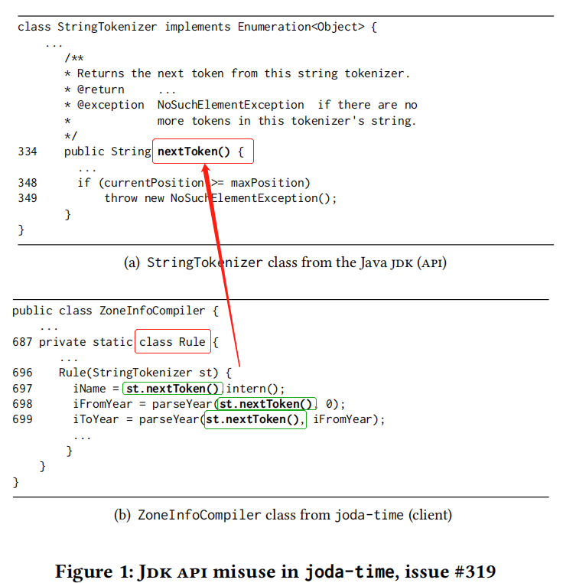
BACKGROUND
st < 3 tokens cause crash
crash-related misuses that can trigger exceptions
this work is the first that studies the relationship between search-based test case generation and crash-related api misuses

Slide 6
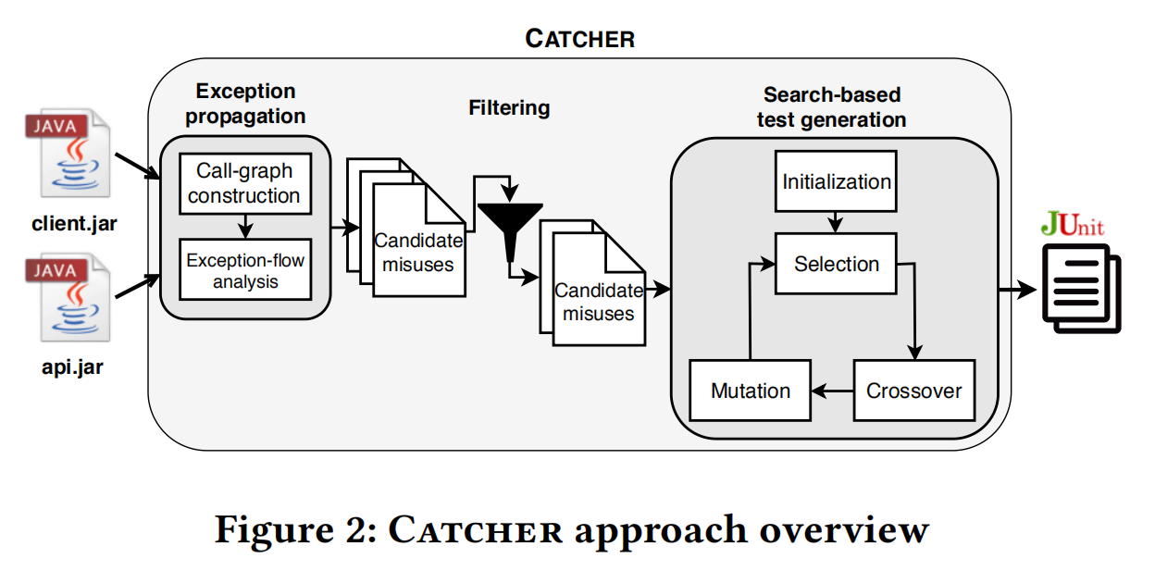
Catcher Approach

Slide 7
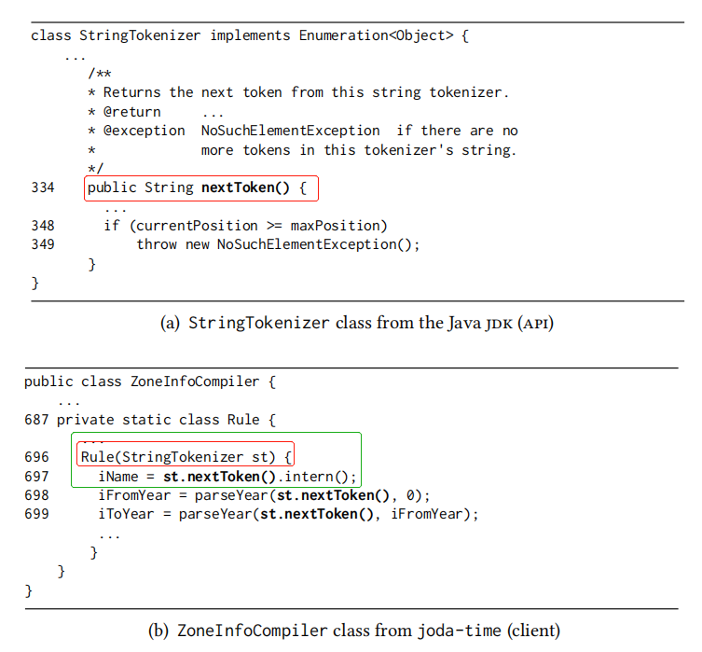
Call-graph Construction
Application Call-graph
API Call-graph
Rule
Enumeration
nextToken
nextToken
NoSuchElementException

Slide 8
Exception-flow Analysis
Application Call-graph
API Call-graph
Node
K<=4
NodeA
NodeB
Rule
Enumeration
NodeBB
NodeAA
NodeBBB
nextToken
nextToken
XException
NoSuchElementException

Slide 9
Filtering
(i) calls to the api within a try-catch construct catching the propagated exception. Moreover,
(ii) calls to the api within a method itself declaring a propagation of the exception using a throws clause.

Slide 10
Focused Search-based Test Generation
A candidate misuse is successfully identified by a test case:
  covers the candidate api call in the client class (the call site),
  triggers the propagated exception,
  the last stack trace element in the crash stack trace is the (misused) api method.
an adequate heuristic to guide a search algorithm

Slide 11

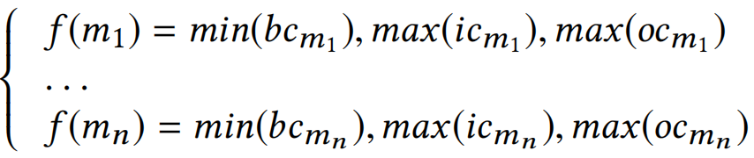
Focused Search-based Test Generation - Heuristic
方法优先级别
m - misuse
b - branch
t - test suite
al - approach level
bd - branch distance
norm - normalized
ic - input coverage
oc - output coverage
正则化的分支距离

Slide 12
Focused Search-based Test Generation - Search Algorithm
Catcher is a multi-target problem since a client class can contain multiple candidate misuses (targets) to be covered.
Dynamic Many-Objective Sorting Algorithm (DynaMOSA)
  Initialization。从候选滥用集合M开始。生成一组随机测试用例，产生初始集合。
  Selection。DynaMOSA使用偏好排序。对于每个候选滥用m，偏好排序会采用最佳的测试用例，并将其插入下一个集合中。通过非支配排序算法对其余测试用例进行排序和选择。
  Reproduction。每一次迭代中，使用竞争选择来选择父母，并通过应用交叉和变异算子来创建新的测试用例。
  Objective update。一旦测试用例到达API call site，就必须抛出m中的异常，并通过传播该异常。确认该测试样例为测试样例集的一部分。
  Termination。迭代过程一直持续到M被覆盖或搜索时间结束为止。

Slide 13
Catcher Approach

Slide 14
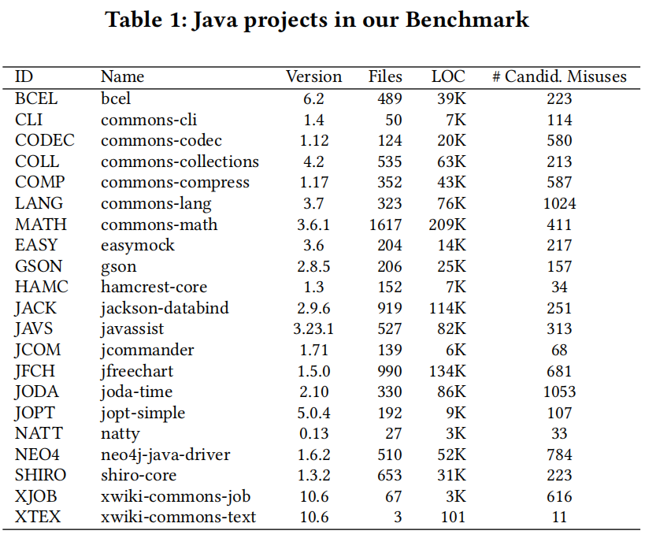
EVALUATION PROTOCOL - Study Context
21 open-source Java projects
well-known,
regularly maintained,
have been already used in the related literature to assess the performance of testing tools
different sizes, development teams, and application domains
Java jdk (version 1.8.0_181)

Slide 15
EVALUATION PROTOCOL - Research Questions
RQ1: How do existing unit level coverage-based test generation tools perform in discovering api misuses?
  The first to apply and evaluate such tools to study how they help to expose api misuses.
RQ2: Does Catcher improve the performance of existing test coverage-based approaches on detecting api misuses?
  considering only exceptions API misuses better than EvoSuite
RQ3: What types of api misuses does Catcher expose?
  constraint misuses and exception handling misuses

Slide 16
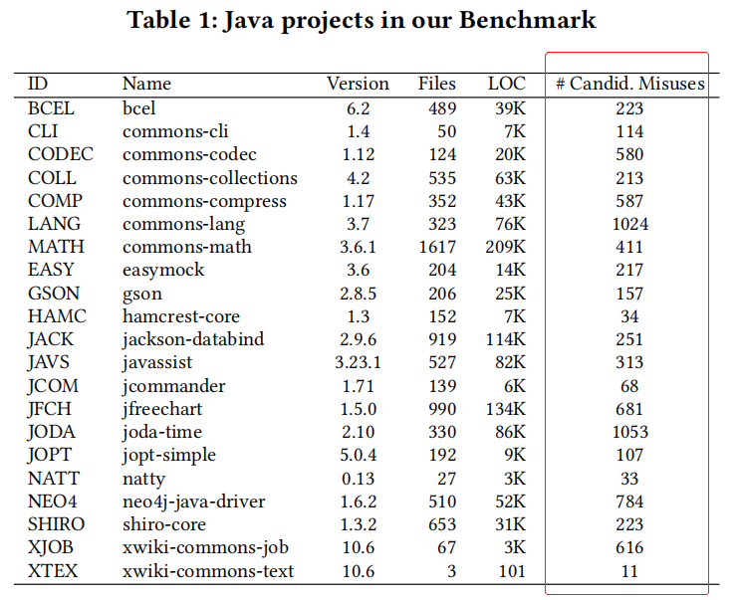

EVALUATION PROTOCOL - Baseline
select EvoSuite as baseline
Both EvoSuite and Catcher share the same search algorithm and the same test case generation engine
EvoSuite：all source code elements for code coverage optimization
Catcher：targets only candidate APIs misuses，input and output coverage for the client methods (callers) containing candidate misuses
Parameter Setting：default parameter values

Slide 17
EVALUATION PROTOCOL - Experimental Protocol
Ran each tool 25 times on each class under test.
EvoSuite：all the classes in the benchmark projects.
  8409 * 25 = 210,225 (per 3 mins)
Catcher：only those classes identified as having candidate api misuses
  905 * 25 = 22,625 (per 3 mins)
Automated the analysis using a script which checks whether the propagated exceptions were adequately documented
  In the APIs of the Java jdk javadoc
  In the source code comments of the callers

Slide 18
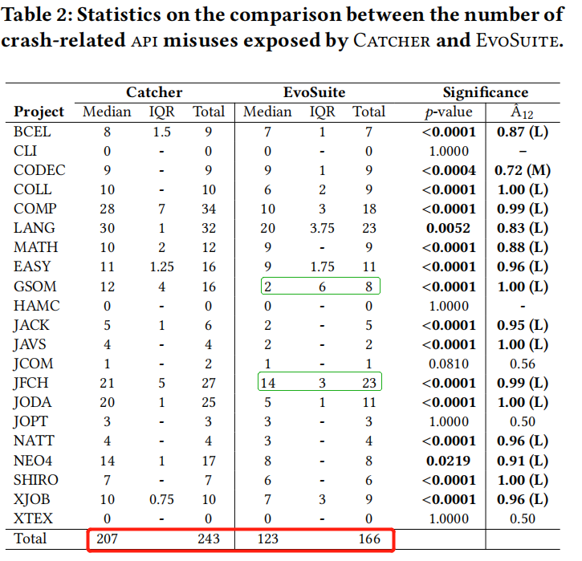
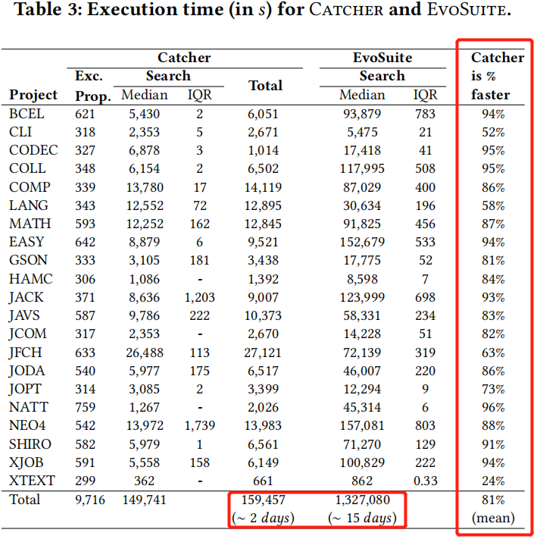
RESULTS
To have more reliable results, we would need to run EvoSuite multiple times

Slide 19
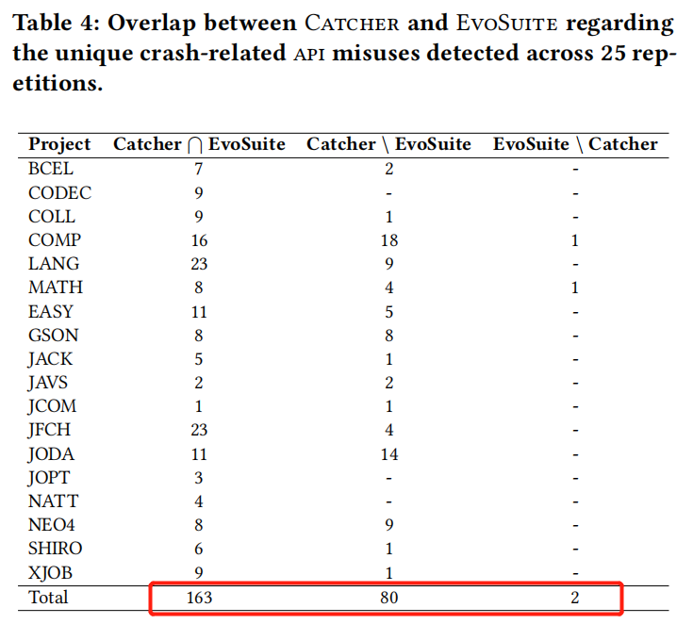
RESULTS
weak mutation coverage

Slide 20
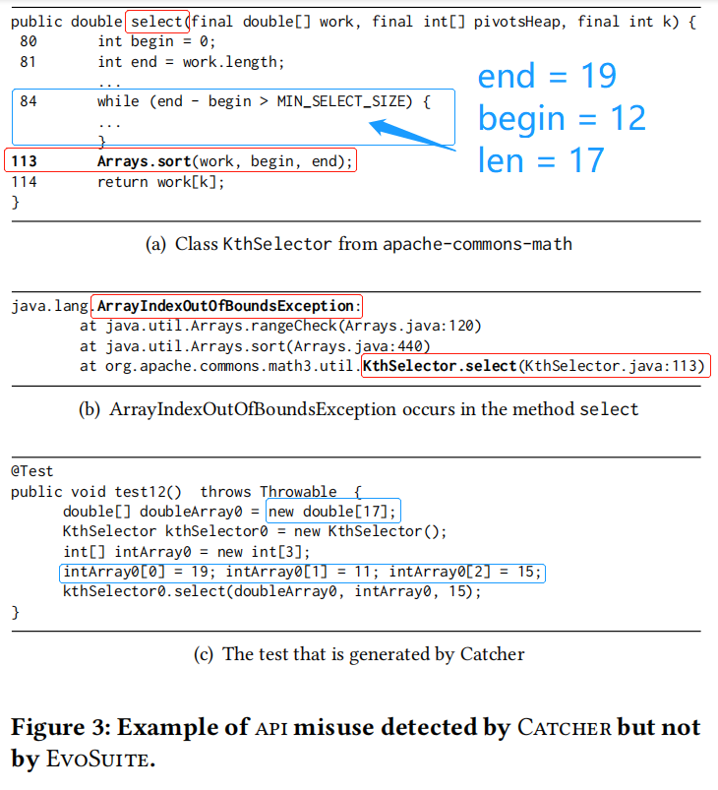
RESULTS

Slide 21
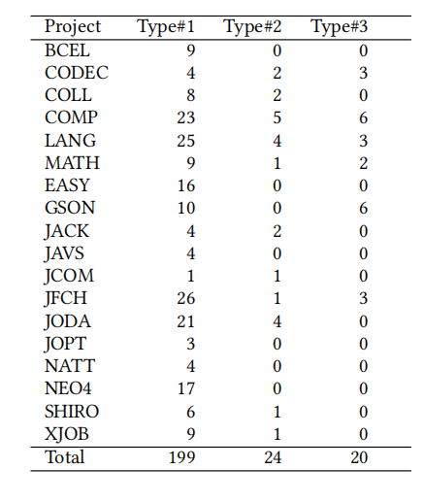
RESULTS
Type#1.(82%)
  Complete API documentation - Inconsistent client
Type#2. (20%)
  Incomplete API documentation - Unaware client.
Type#3. (8%)
  Complete API documentation - Consistent client.

Slide 22
DISCUSS
Introduce support for longer exception propagation chains to cover deeply nested api calls;
Consider third-party libraries in the analysis to cover the runtime exceptions they introduce;
Different types of api misuses;
More studies that combine the strengths of static analysis and automated search-based test case generation;

Slide 23
CONCLUSION
Catcher, that combines static exception propagation analysis and search-based testing to effectively and efficiently identify and expose api misuses in client programs.
Validate 21 Java applications, targeting misuses of the Java platform's api. Catcher is able to efficiently generate test cases that uncover 243 api misuses leading to crashes.
Better than EvoSuite, less time than EvoSuite.

Slide 24
THANKS！

